Slide 1
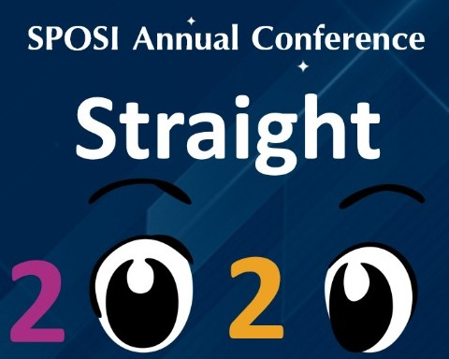



Slide 2
INOVATIVE METHODS OF ANAESTHESIA FOR EYE SURGERY IN CHILDREN
DR Mrugesha Vaghela
CO-AUTHORS: DR. Shreya Shah
DR. Mehul Shah
DR. Ruchi Bodat

Slide 3
AIM & METHODS:
AIM: To study effectiveness of innovative method of anaesthesia using regional anaesthesia for eye surgeries in paediatric age group.
Material and Methods: This is a retrospective study done at tertiary eye care center in central western India. We retrieved data from Medical Record Department for all children (0 to 18) who had undergone ocular surgeries between January 2008 to December 2013 at tertiary eye care centre. Sedation along with regional anaesthesia (topical or peribulbar block) or general anaesthesia was the preferred mode of anaesthesia under which cataract, strabismus, lacrimal, ocular trauma and retinal surgeries were performed. All surgeries, methods, medicines and complications of anaesthesia were properly documented

Slide 4
INTRODUCTION:
Common causes of blindness in paediatric age group are refractive errors, congenital malformations, Cataract, Strabismus, Ocular injuries etc[6,7,8]. Amongst these many are treatable causes. Now with VISON 2020 and NPCB initiatives childhood blindness elimination is an important branch. Now a days more and more students are choosing paediatric ophthalmology as their sub speciality, availing themselves of many training programs[1,2]. As many as 40 centres in our country are working for this cause in tandem with government as well as Non Government Organizations.
Childhood blindness is one of the most important factors causing social and economic burden to society[1-6]. It is also one the leading causes of blindness. Since blind children’s life span is usually greater than adult blinds, their lives become more painful, abnormal, and dependent.

Slide 5
Some NGOs like ORBIS international have taken up initiative for eli.mination of childhood blindness. One of the main obstacles to this specialty is anaesthesia for paediatric eye surgeries. And expertise in this field is not easily and readily available in our country.
General anaesthesia has traditionally been considered to be appropriate for those traumas extensive enough to require surgical intervention, but the anaesthetist must balance specific risks: force placed upon the eye during anaesthesia
General anaesthesia has traditionally been considered to be appropriate for those traumas extensive enough to require surgical intervention, but the anaesthetist must balance specific risks: force placed upon the eye during anaesthesia manoeuvres such as mask-ventilation, laryngoscopy, and intubation, or due to coughing or bucking .
We need to have different consideration for different ocular condition: as in open globe ocular injuries intra ocular pressure is the issue to take care of; the shadow of oculo cardiac reflex is always lurking in neighbourhood in strabismus surgeries and possibility of aspiration when irrigation is done in lacrimal surgeries can never be ignored

Slide 6
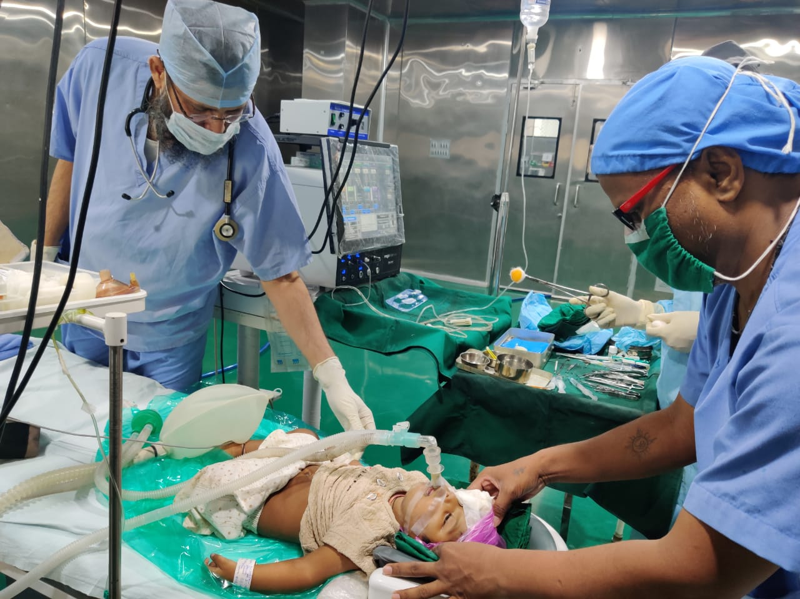
Western experience might not prove useful because of our socio-economic and demographic factors. We have tried to study this innovative method of anaesthesia which is cost effective and does not need very expensive infrastructure, in order to provide evidence that this method can offer solutions for safe and cost effective anaesthesia for children undergoing eye surgeries.

Slide 7
METHODS AND MATERIAL:
Endo tracheal intubation, Laryngeal mask or I gel were used to maintain air way. In All these cases Intravenous Anaesthesia was administered. The manner of anaesthesia was decided on the basis of Innovative Methods of Anaesthesia for Eye Surgery
Significant deciding factors were Intra ocular pressure, oculo cardiac reflex and integrity of ocular walls.
Approval obtained from Hospital ethical committee for this study. In this retrospective study we enrolled children 0-18 years our Electronic Medical Records who had undergone any type of eye surgery during January 2004 to December 2013.
We have also documented methods of single or combination anaesthesia methods. They included general anaesthesia using anaesthetic agents, general with regional anaesthesia in the form of topical anaesthesia (Lignocaine 4%) or peri bulbar block using (Lignocaine 2% and Sensorcaine 0.5%).

Slide 8
In All these cases Intravenous Anaesthesia was administered. The manner of anaesthesia was decided on the basis of Innovative Methods of Anaesthesia for Eye Surgery
Significant deciding factors were Intra ocular pressure, oculo cardiac reflex and integrity of ocular walls. All these procedures were done at National Accreditation Board of Hospitals accredited eye hospital having tertiary care facilities.
All patients were given Premedication in form Glycopyrolate and Ondansetron. For all wound repair topical with total Intravenous Anaesthesia along with Laryngeal Mask Airway/IGEL was used. This method was selected in order to facilitate the control of IOP. For all lacrimal surgery endotracheal intubation with intra venous anaesthesia was employed. Endo tracheal intubation prevented the chance aspiration due to irrigation done during lacrimal surgeries. For all cataracts including traumatic cataracts total intravenous anaesthesia along with peribulbar was preferred; as peribulbar

Slide 9
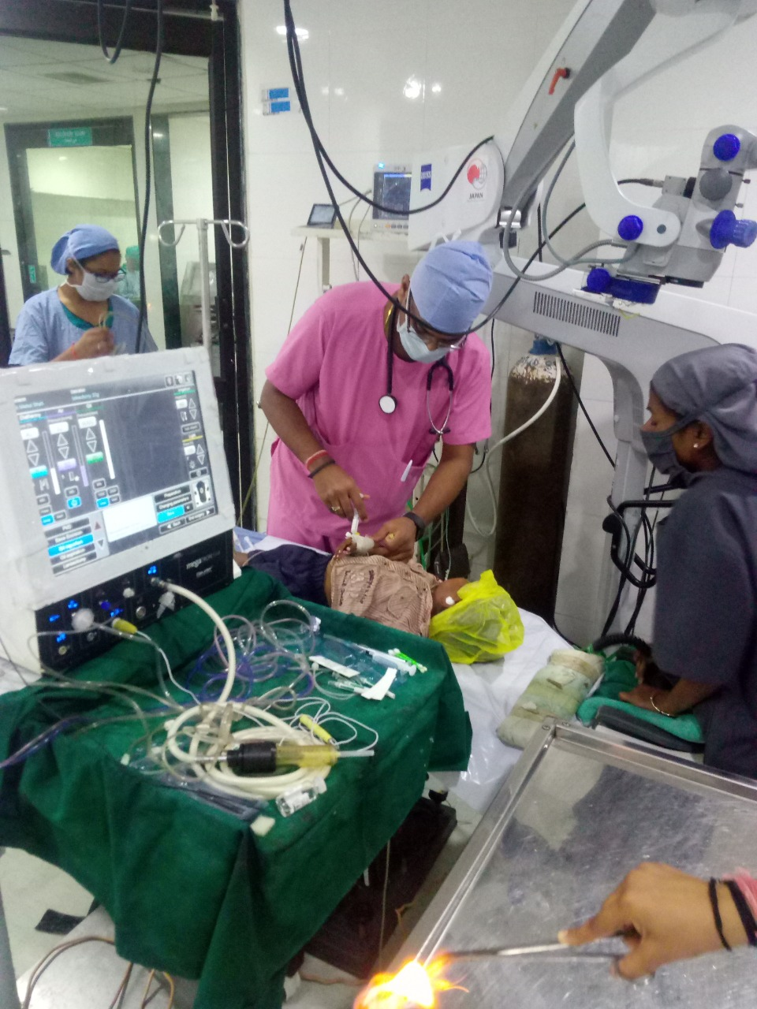
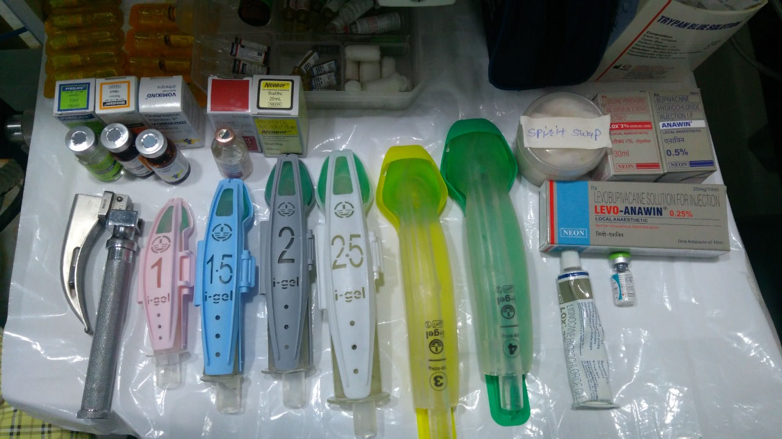

Slide 10
Post op regiME:
Post-operative monitoring was done at surgical ICU in presence of a qualified nurse and an anaesthetist. All post-operative anaesthesia complications were documented. All data was exported to excel sheet and analysed with SPSS 22. Descriptive statistics and frequency were used to analyse these data. Results In all 1941 cases including 1084 males and 857 females (Table-1) out of which 520 were cataract, 723 were strabismus, 285 were lacrimal surgeries, 185 were ocular trauma and 228 retinal surgeries- were operated.(Table-2)
Median age of patients was 8+/-4.8(0 to 17). All the surgeries were accomplished uneventful manner. We could administer anaesthesia in 83.3% cases with general and regional anaesthesia (Table-3, 4, 5). We did not come across any significant anaesthesia complication except in 2 patients who developed bleeding during nasolacrimal intubation, but as endotracheal intubation was on any untoward sequelae was averted Post-operative nausea vomiting (PONV) in 5% cases was documented.

Slide 11
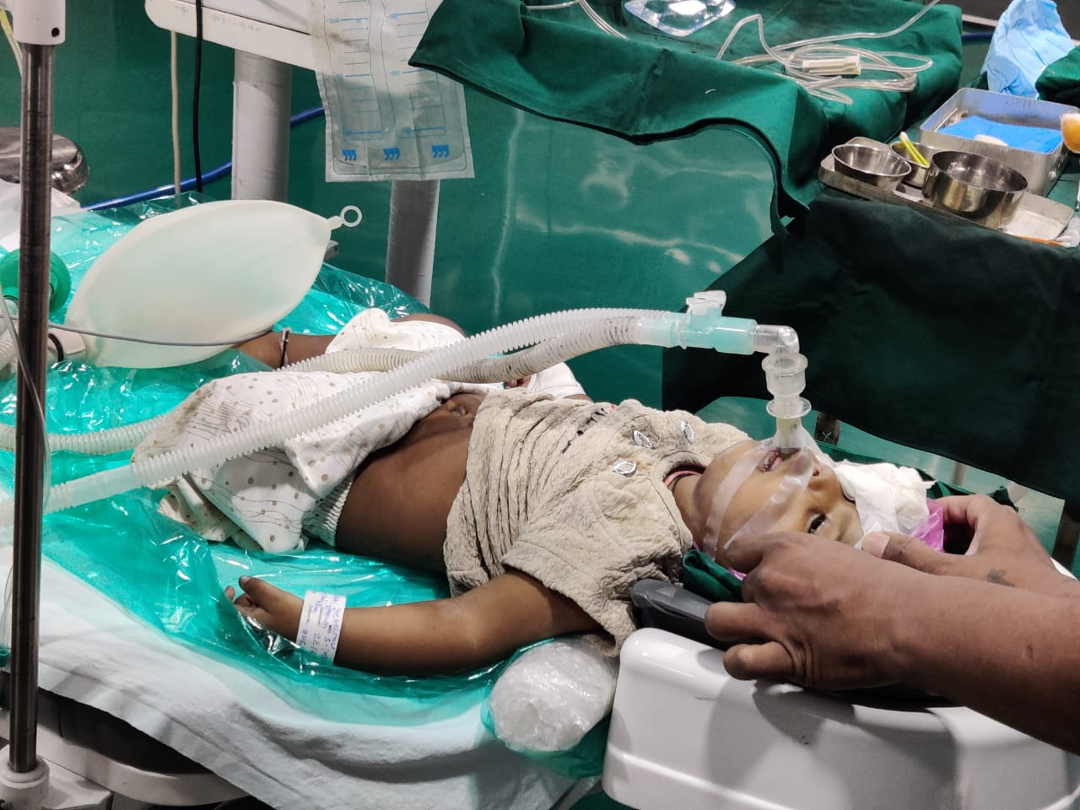

Slide 12
Results:
all 1941 cases including 1084 males and 857 females- (Discussion Table-1) out of which 520 were cataract, 723 were strabismus, 285 were lacrimal surgeries, 185 were ocular trauma and 228 retinal were surgeries- were operated.(Table-2) Median age of patients was 8+/-4.8(0 to 17).
Childhood blindness is an important initiative of vision 2020. We have very limited number of paediatric anaesthetist which is a hindrance to successful outcome of childhood blindness[1,2]. Most of the anaesthetists are not familiar with sIn pecific technical complexities of paediatric ocular conditions[1,2]. General anaesthesia has traditionally been considered to be appropriate for anaesthesia in children[10,11]. But now techniques for anaesthesia in children for ocular surgeries are re strategized keeping in view specific issues regarding the type of surgeries, cost effectiveness and expertise of anaesthetist[12].
Auffarth et al reported topical anaesthesia for open globe injury[13] but number of cases are very small as compared to current study. Frenesco has reported sedation along with topical lignocaine for open globe injury[14]. Steven gayer has reported rethinking strategies for anaesthesia for ocular injuries[12].

Slide 13
Discussion:
Ana Wilson also has discusses and reported alternates to general anaesthesia for ocular injuries[15]. Sinha et al reportwww.ommegaonline.com J Anesth Surg -Anesthesia Methods & Eye Surgery ed various techniques for regional anaesthesia for ocular injuries[16]. Shireen Ahmed reported in a current study various levels of sedation as well as sedation along with topical anaesthesia for wound repair in open globe injury[17].
Ghai found subtenon block a better alternative with regards to post-operative analgesia as compared to fentanyl for cataract surgery in children[18].x[9].
We are not aware of and have not come across any database published with such a large series. Conclusion It is an inescapable conclusion that surgery specific anaesthesia is very effective method. Endo tracheal intubation is safe and effective strategy for lacrimal surgeries. Regional anaesthesia with sedation or general anaesthesia is effective for cataract, retinal or strabismus surgeries in children.

Slide 14
conclusion:
It is an inescapable conclusion that surgery specific anaesthesia is very effective method. Endo tracheal intubation is safe and effective strategy for lacrimal surgeries. Regional anaesthesia with sedation or general anaesthesia is effective for cataract, retinal or strabismus surgeries in children.

